Slide 1
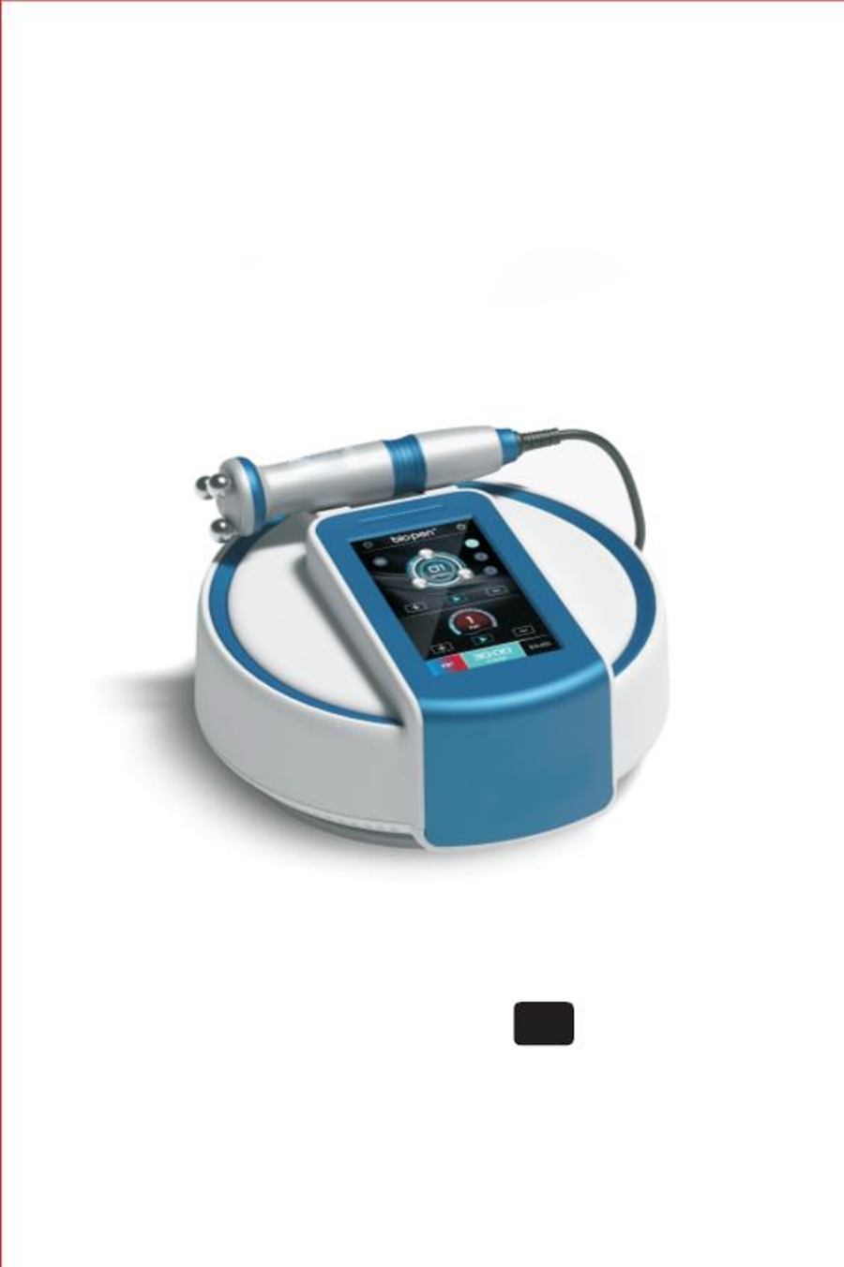
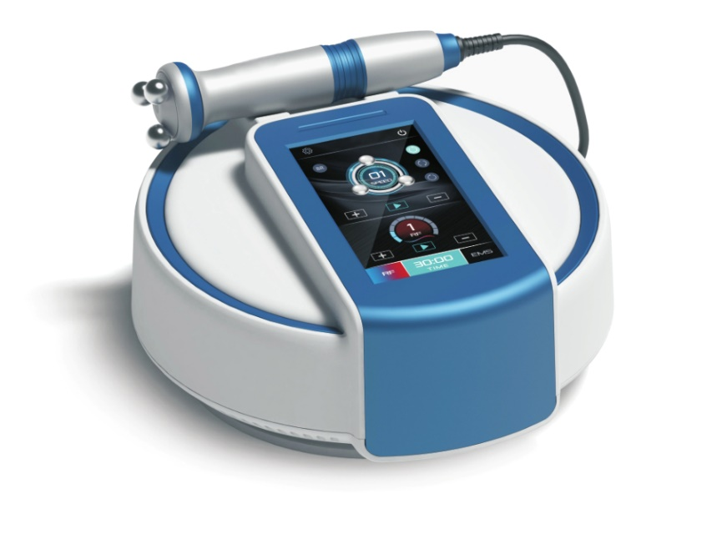
User Manual EN
Please read the manual before use

Slide 2
Contents
1
Product components
Warning
2
3
4
5
Advantage
Basic Operation
Basic Operation
Basic Operation
Basic Operation
Specification
6
7
8
9
Maintenance
Warranty
9
9
Package list
Precaution
9
10

Slide 3
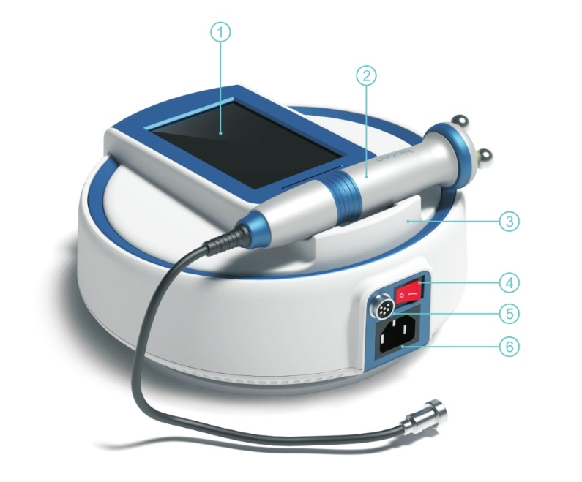
Product components
2
1
2
3
4
5
6
1
Touch screen
2
Handpiece
3
5
Handpiece bracket
Handpiece socket
4
6
Power switch
Power socket

Slide 4
Benefits
4
This device has both Radio Frequency (RF) and Microcurrent (EMS) technologies.
RF is a skin heating therapy that stimulates and regenerates collagen. It reduces wrinkles and firms the skin.
EMS enhances cell activity, promotes muscle exercise, and restores the skins elasticity. It accelerates blood circulation and promotes the absorption of nutrients into the tissue.
The 360-degree rotating handpiece can be rotated forward or reverse, or it can be rotated alternately.
The rotation speed is adjustable. The 360-degree rotating massage head helps with blood circulation, and it feels good.
Combine with blue light phototherapy to achieve even better skin care results. Blue light is good for acne reduction and calming the skin.
Safe: non-invasive, does not burn the skin.
Ease of use: This machine is quite easy to use.
Comfortable for client: Feels like a tapotement massage.
Efficient modalities: RF and EMS, and combination of rotation and blue light therapy.
Contraindications: Pregnancy Pacemaker Active lesions or cancer on area being used.

Slide 5
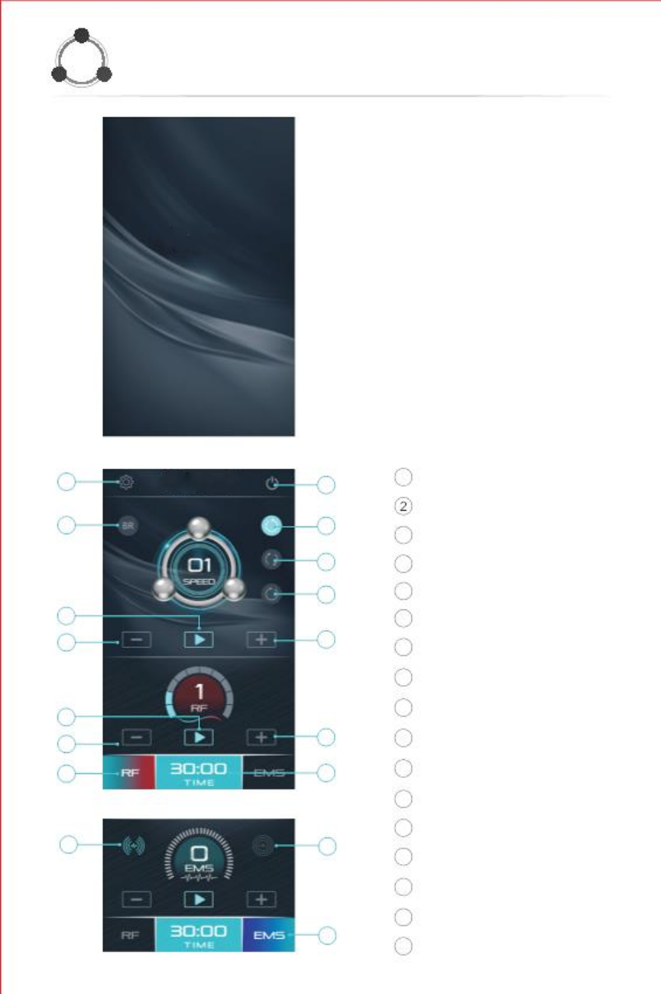
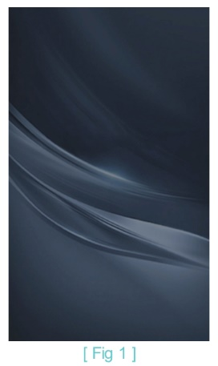
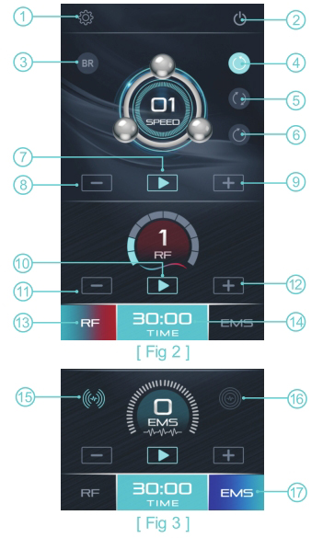
Basic Operation
5
1. Connect accessories to the unit.
Connect the handpiece to the handpiece
socket of unit and connect the adapter to
the power socket of unit)
2.Plug DC adapter to AC outlet.
3.Turn on the power switch
to enter boot interface as [Fig 1].
4.Tap the interface panel [Fig 1] to
open the home interface as [Fig 2] .
5.It will show below interface as [Fig 3]
EMS function is the default.
[ Fig 1 ]
1
3
2
4
1
Settings
Shutdown
Blue Ray
3
4
5
6
7
5
6
Reverse rotation
Alternate rotation
Forward rotation
Rotation start/pause
7
8
9
8
9
Rotation speed down
Rotation speed up
10
11
10 RF/EMS start/pause
11 RF/EMS intensity down
12 RF/EMS intensity up
13 RF mode
12
14
13
[ Fig 2 ]
15
16
17
14 Working time
15 Discontinuous pulse
16 Continuous pulse
17 EMS mode
[ Fig 3 ]

Slide 6
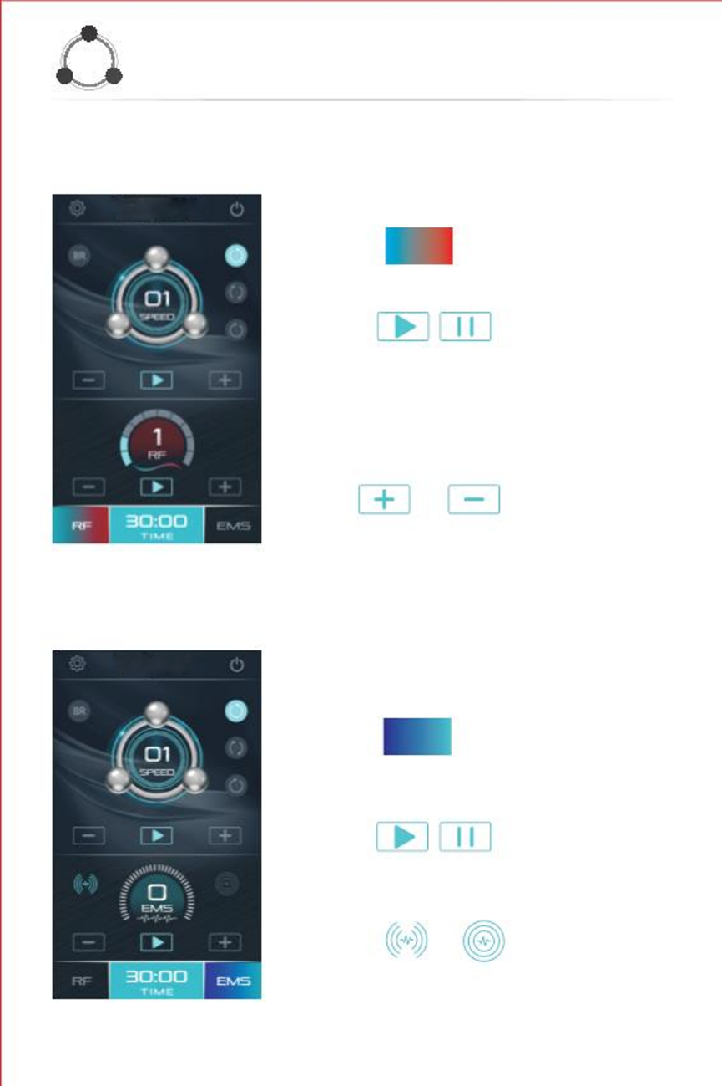
Basic Operation
6
6. Please use mode suitable for the client. Select RF or EMS.
RF Mode:
[1] Click
RF
to select the RF mode.
In interface as [Fig 4] .
[2] Click
RF treatment.
[3] Adjust the RF intensity :
to start or pause the
Adjust the RF intensity according to different
clients and different treatment sites.
The system default RF intensity is 1.
Click
or
to adjust.
The range is from 1 (weak) to 5 (strong).
[ Fig 4 ]
Notice:
The intensity of RF can be adjusted
only after starting the RF.
EMS Mode:
[1] Click ems to select the EMS mode.
In interface as [Fig 5] .
[2] Click
the EMS treatment.
to start or pause
[3] Click
or
to
choose the mode of EMS pulse.
[ Fig 5 ]

Slide 7
Basic Operation
7
This button is for pulsating mode.
This button is for continuous mode.
[4] Adjust the EMS intensity : Adjust the RF intensity according to the
Client's comfort. The range is from 1 (weak) to 5 (strong).
or
to adjust.
Notice:The intensity of EMS can be adjusted only after starting the EMS.
7.Operation of Rotation
[1] Click
or
or
to choose the mode of rotation.
This button is for reverse rotation.
This button is for forward and reverse alternately.
This button is for forward rotation.
to start or pause the rotation.
[2] Click
[3] Adjust the speed of rotation : Adjust the rotation speed according to different
clients and different treatment sites.Click
The range is from 1 (slow) to 5 (fast).
or
to adjust.
Notice:The speed of rotation can be adjusted only after starting the rotation.
8.Operation of light therapy
[1] Click BR to start or stop blue light.

Slide 8
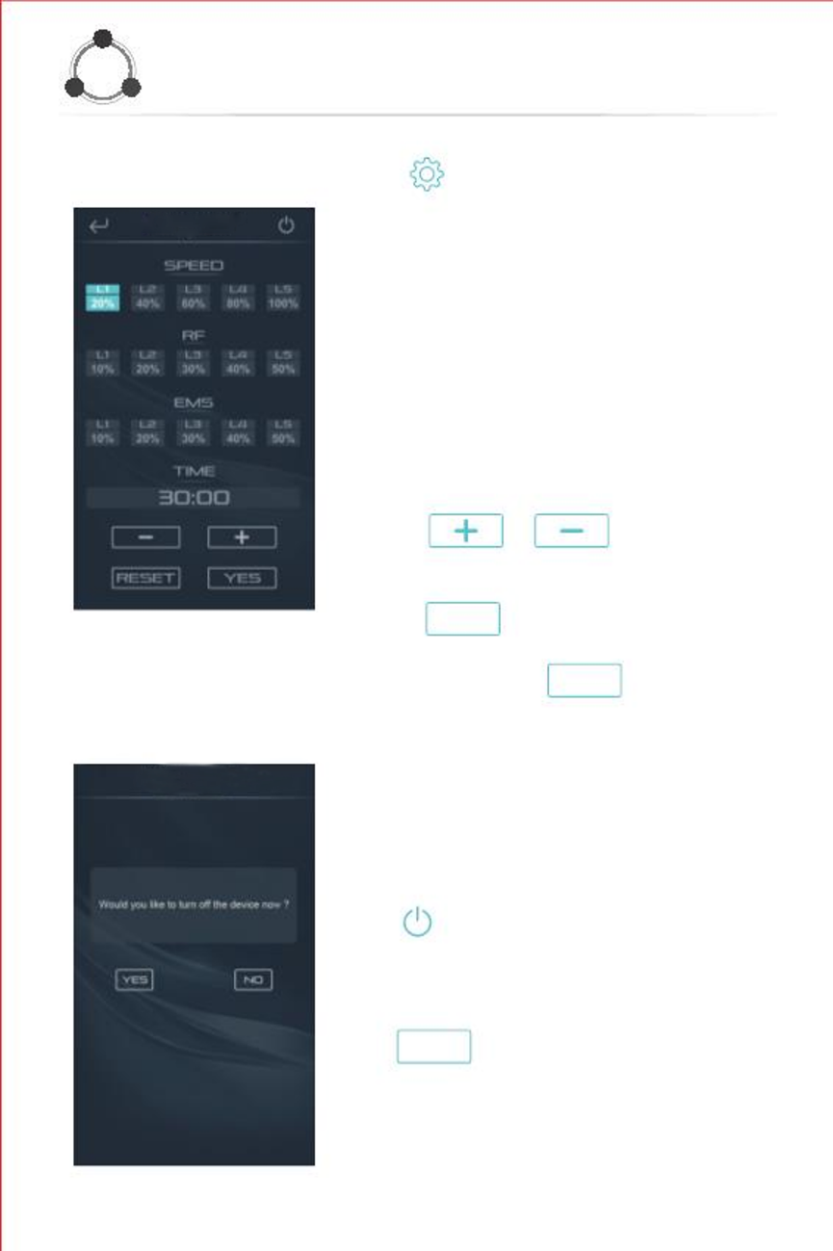
Basic Operation
8
Click
[Fig 6].
to enter the setting interface as
Set default parameter for each function.
Please set default parameter for each level
of rotation speed & RF & EMS and working
time according to your need.
[1] Select the level for corresponding mode
or working time.
Notice:
The default working time is 30 minutes.
The maximal working time is 99 minutes.
[2] Click
parameter.
or
to adjust the
[3] Click
YES
to finish adjusting parameter.
[ Fig 6 ]
[4] Press and hold the ^{reset} button for 4-5
seconds if you want to reset all parameter.
Turn off the machine
Click
Click
to enter the interface as [ Fig 7 ] .
to turn off the machine.
YES
[ Fig 7 ]

Slide 9
Warning
3
To fully understand this machine, we suggest that you read the following instructions carefully before use.
Please follow the instructions to properly install and operate the machine.
Please do not disassemble and replace any accessories of the machine.
Opening and removal of the console by anyone other than authorized company
personnel is prohibited.
If any problem occurs during operation, please contact us.
Do not use electricity other than 22V
Do not detach the cord from wall socket with wet hands.
Do not use cord if cracked or split.
Do not leave plugged in if not using on a regular basis.

Slide 10
Specification
9
【Model name】: T6
【Weight】:2.8 kg
【Adapter】:100V~240V
【Size】:320*280*150 mm
【Patented product】:Yes
【Purpose of Use】:Skin therapy
Warranty
The warranty period of the device is 12 months for manufacturing issues. The unit will need to be sent to us for inspection before replacement will be sent.
Package list
1 Base
1 Handpiece
1 Adapter & cord
RF frequency is 1MHz, voltage is 18-24W.
EMS energy is 350μA, power is 18-24W.

Slide 11
Treatment Ideas Start by performing your regular facial treatment (cleanse, exfoliate, etc.). The 360 Toner may be used in conjunction with other pieces of equipment. I prefer to use it toward the end of the treatment and leave the product on face. You will need to apply a product or product concoction that conducts well. I use our anti-aging moisturizer with oxypro and/or firm & hydrate mask. I like to add a couple sprays of Rose Water for the scent. If you are doing this as a standalone toning treatment, I recommend doing 10 minutes on each side of the face. I especially see great results with this equipment on the neck and jawline. If you are using the 360 toner with other equipment, 5 minutes each side of the face will give you nice results. Use upward movements starting at the neckline. This treatment feels better and will achieve better results with slow movements. It’s very relaxing for the client. Play around with the speed of the rotation and the level of the current (RF or EMS) with each client. Also experiment with which way you prefer the rotation. You can do forward or reverse. There is also alternate rotation which I am not a big fan of but try it for yourself.
Video Link https://youtu.be/hJs01Ej6AYY

